Slide 1

Proof Of Work
Proof
What is Work?
Work
Computation Effort
Expended Effort

Slide 2
Proof Of Work
What is Proof?
Verifier
Prover
Proof
Verifier
Verifier

Slide 3
Proof Of Work
Hash Cash Based Proof Of Work
Random Number -R
Hash SHA1(R) = H
If (H ~ 000000 ….)
Proof Calculated
Else
Increment Counter ReCalculate
Check Hash (R) == 00000ZBCD

Slide 4
Proof Of Work
Uses -
Email Spam elimination
Add the following header:
X-Hashcash: 1:20:1303030600:anni@cypherspace.org::McMybZIhxKXu57jd:ckvi
ver: Hashcash format version, 1 (which supersedes version 0).
bits: Number of "partial pre-image" (zero) bits in the hashed code.
date: The time that the message was sent, in the format YYMMDD[hhmm[ss]].
resource: Resource data string being transmitted, e.g., an IP address or email address.
ext: Extension (optional; ignored in version 1).
rand: String of random characters, encoded in base-64 format.
counter: Binary counter, encoded in base-64 format.

Slide 5
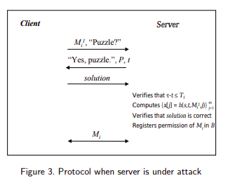
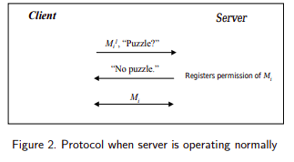
Proof Of Work
Uses -
Denial Of Service Protection

Slide 6
Proof Of Work
Bitcoin Proof Of Work
00000000000xshduhd….
00000000000xshduhd….
00000000000xshduhd….
00000000000xshduhd….
00000000000xshduhd….
00000000000xshduhd….
00000000000xshduhd….
Block N
00000000000xshduhd….

Slide 7
Proof Of Work
Demonstrate Proof Of work in Java/JavaScript

